Slide 1
VBA for Excel
Pôle Universitaire Léonard de Vinci
Session 1
Achraf Seddik
seddik.achraf.1@gmail.com

Slide 2
Summary
Introduction to programming
Getting started with VBA
Inputs and Outputs
Conditional structures
Looping
Arrays and Excel cells
Functions

Slide 3
1. Introduction to programming
What is programming ?
Sequences of instructions that allow you to give commands to a computer (a language that the computer-software understands to answer you)
A programming language is a language intended to describe a set of consecutive actions that a computer must perform. A programming language is thus a convenient way for us (humans) to give instructions to a computer.
What is it used for ?
Automate recurring tasks, develop applications, perform complex calculations, develop (small) programs
Some programming languages:
Visual Basic, C, C++, JAVA, Python, PHP, R, SAS, SQL

Slide 4
I - Introduction to programming
Main differences between languages:
– Syntax : Syntax of the language and also the logic
– Paradigm : Object-oriented, functional, relational etc.
– Use : Languages Specially adapted to:
• Internet (web pages): PHP, Perl, JAVA
• Simulations and numerical calculs : Matlab, Scilab
• Machine learning : R, Python
Note : Mastering one language makes it generally easy to handle other languages

Slide 5
VBA ou VB or Visual Basic
The terminology can be ambiguous :
- VB = Visual Basic
The programming language in it self, which is available in MS Office but also into Visual Studio in order to create independent applications
- VBA = Visual Basic for Application
Application of VB into some softwares such as MS Office (Excel, Access, Word)
> VBA is an extension of VB > we can only execute the code into a host application (here Microsoft Office) ; the application is not autonomous.

Slide 6
VBA : Advantages et disadvantages
Advantages :
– “Simplicity”
– Available in MS Office : no need to install a new software or code editor
– can access windows functions such as dialog boxes etc.
Disadvantages :
– Not optimized for treating large data sets
– Not very efficent
– Depend on Windows and MS Office

Slide 7
Host applications for VBA :
Word
Excel,
Access,
Autocad, CATIA v5 (…)
In finance (banking and insurance) :
→ VBA for Excel
Aim : Realise and program all we already can do with Excel and more

Slide 8
2. Getting started with VBA and 1st Macro :
« Fichier > Options > Personnaliser le Ruban » then check "Développeur".
>to get :

Slide 9
To work with VBA code, we need a code editor, this latter is already installed and you can open it with the shortcut "Alt+F11" :
> Or : tab « Développeur »/Editeur VBA
We are ready to code

Slide 10
2.1. First macro :
Automatizing the following operations:
Select a cell,
Enter text (for example name),
press return.
Sequence :
Click on "Enregistrer une macro" then "Ok"
Execute the needed operations (attention every manipulation is recorded)
Click on "Arrêter l'enregistrement"
Now (Alt-F11) and click on « Module1 » to visualize the code
Note : a macro (macroinstruction) is a small programming routine

Slide 11
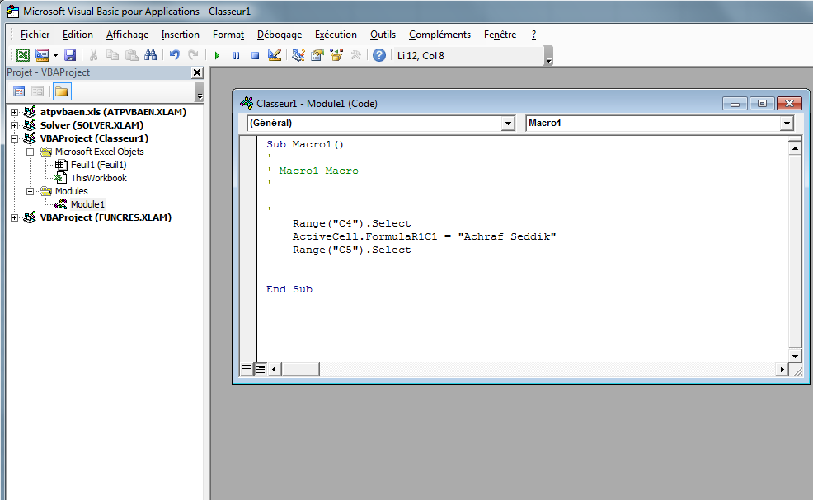
Explanation of the generated code :
Begening and end of the macro :
Sub et End Sub delimits the beginning and the end of the macro, "Macro1" corresponds to the name (title) of this macro

Slide 12
Explanation of the generated code :
Comment :
preceded by an apostrophe ‘
Is not taken into account in the execution of the code (very useful for instance to not to execute certain lines of code without deleting them)
Note : The text of the comment will be automatically have a green color in the vba editor

Slide 13
Explanation of the generated code :
Instructions :
Code that allows you to perform the needed tasks.
Note :
The code can also have a variables declaration part (will be seen later)

Slide 14
Create a Button for this macro

Slide 15
Editing the Macro :
In the VBA editor window:
- Change the name of this macro to something more meaningful,
simply replace "Macro1" by "Write my_name" (NB: the name of the macro must not contain spaces)
- Edit the message displayed by the macro
Application 2 :
Record a macro that allows you to compute the sum of the values in two cells into a third cell and create a button for it.
Record another macro (of your choice)
Save your work : « .xlsm » format must be used
Note : the macro recorder is limited : Not everything is possible to do with it (e.g. msgbox, conditional structures and loops etc.)

Slide 16
2.2 - VBA procedures

Slide 17
2.2 - VBA procedures :
Example 1. Dialog boxes
Dialog Box containing a message:
Msgbox (" [your message] ")
Dialog Box to insert a value message:
InputBox (" [your message] ")
Show the contents of a variable :
& [variable contents]
We can affect a name to these procedures and treat them as variables

Slide 18
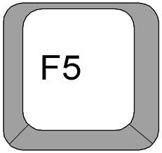
Procedure example: Dialog boxes
Dialog Box containing a message:
A = Msgbox (" Bonjour ")
Dialog Box to insert a value :
B = InputBox (" Enter your name ")
Show the contents of a variable :
MsgBox(" My name is "& A)
Variables A and B
To execute the code

Slide 19
Applications Exercice Sheet N°1

Slide 20
Appendix.
1. VBA variables types
2. Operators
Arithmetic | ^ | - [negation] | * | / | + | & | Mod
Comparaison | = | <> [different] | < | > | <= | >= | Like | Is
Logical | Not | And | Or | Xor | Eqv | Imp

